Slide 1
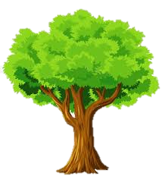

NEW YORK TREE CENSUS 2015 ANALYSIS USING TABLEAU DASHBOARD
ALY6070 21601: Communications and Visualization for Data Analytics
Presented By: Durga Bhanu Nayak
Date: 03-30-2022

Slide 2
Tree Data: 2015 Street Tree Census
The New York Street tree data collected in 2015 by NYC Parks & Recreation personnel and volunteers, as well as other groups. It includes information about the tree’s health status, total count, problems that come, and location, among other things.
We used this data to conduct an in-depth analysis with Tableau and create an interactive dashboard with Tableau Desktop that displays numerous characteristics linked to these trees, including borough-by-borough tree species, count, health, and problem. This dashboard has a side bar style with a side Filter pane for user input and a primary Data panes to represent the visual plots and relevant textual associated with the inputs.

Slide 3
Business Questions
What are the overall statistics of the tree plantation and urban forestry in New York?
How is the distribution of plantation among the Borough & different community Board ?
Which tree species are most dominant across boroughs in New York?
What are the problems associated with the trees and the areas with most affected trees ?
What are the places where guard replacement is required?

Slide 4
Data Used In the Analysis
Geographical Role Selected:
Latitude
Longitude
Postal Code
Borough
Categorical Variable:
Tree Status
Tree Health
Side Walk
Guard
Trunk Problem – By Ropes, By Lights, and By others
Root Problem – By paving stones, By Metal Grates, and By others
Branch Problems – By Lights, By Shoes , and By others
Numerical:
Tree Diameter by Breast Height(Continuous)

Slide 5
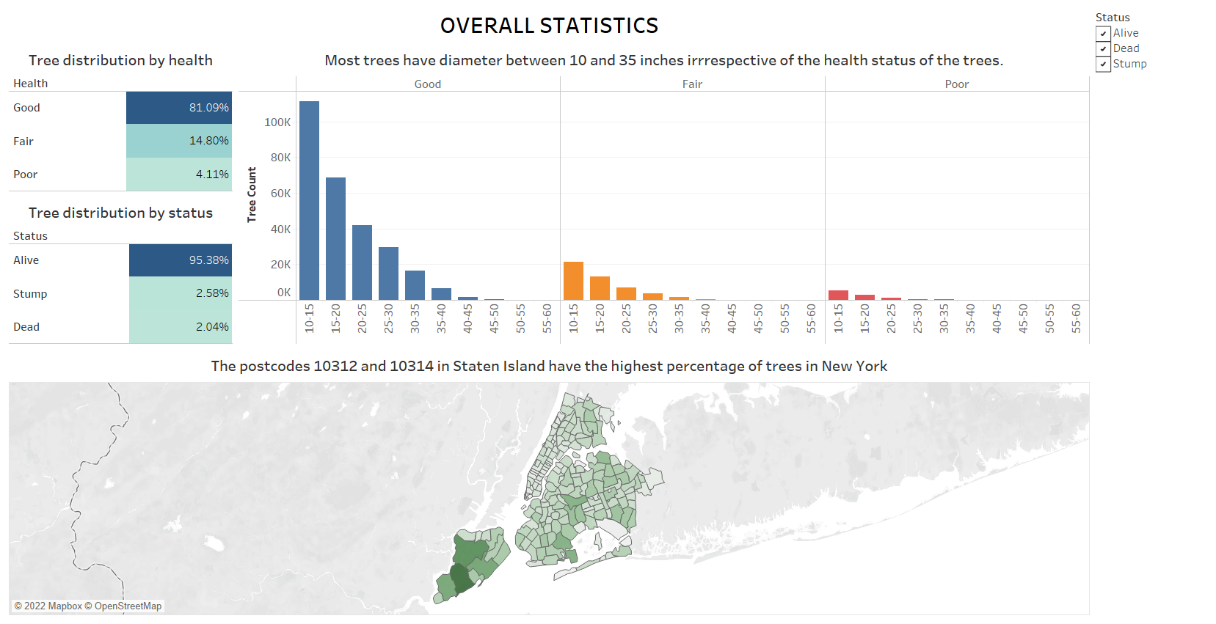

Slide 6
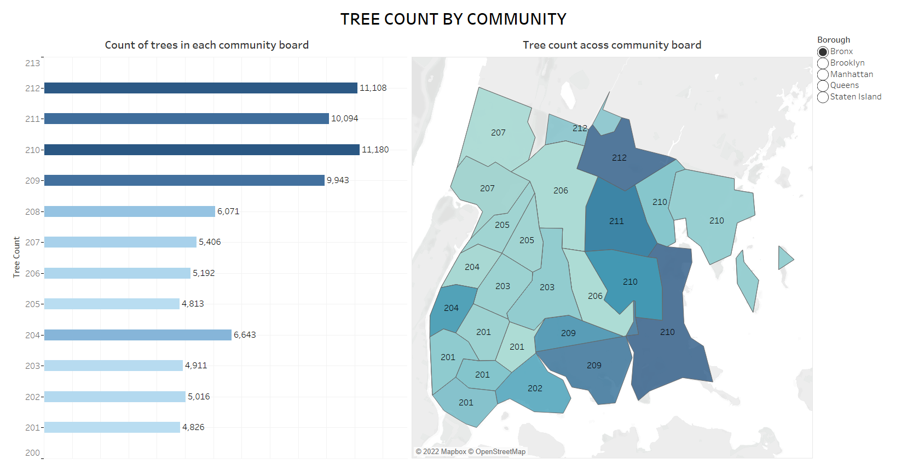

Slide 7
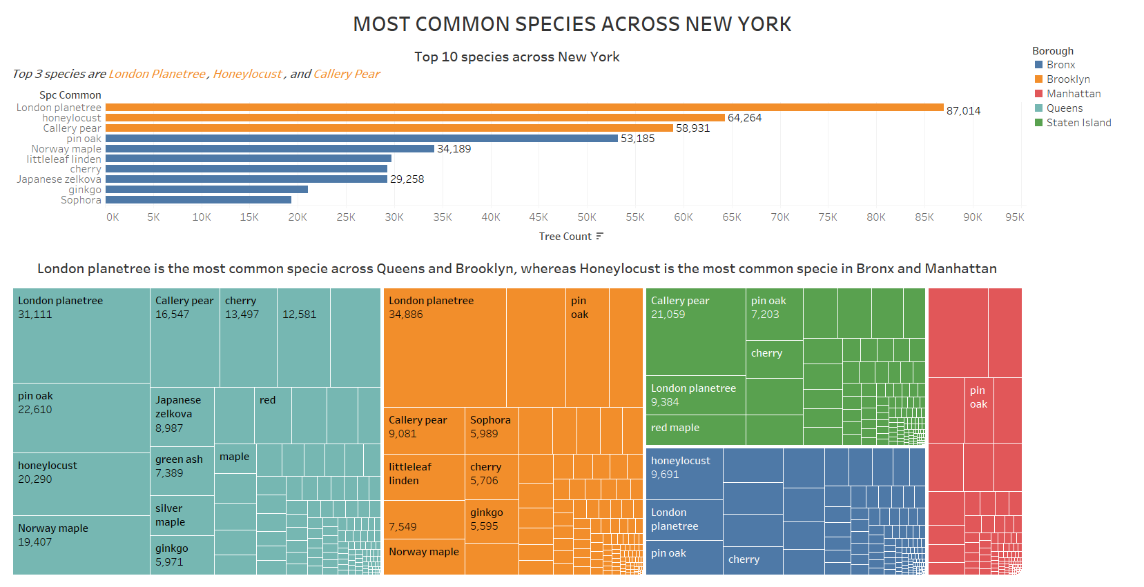

Slide 8
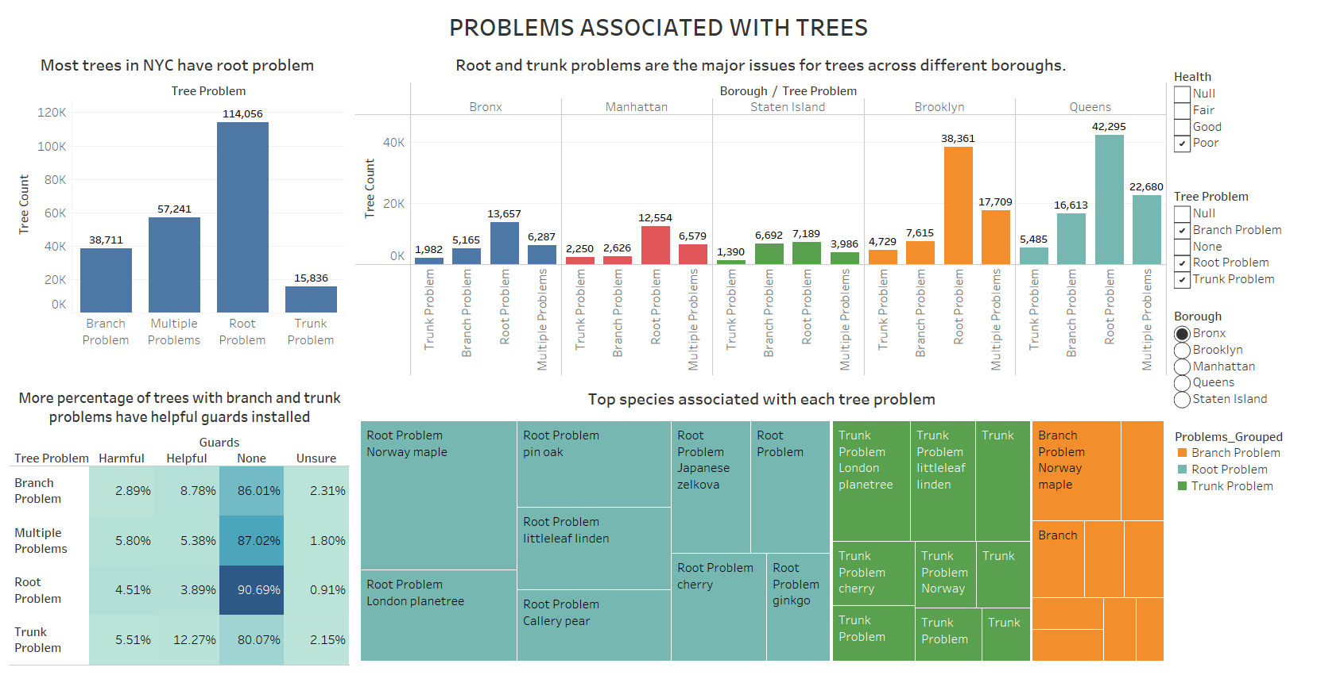

Slide 9
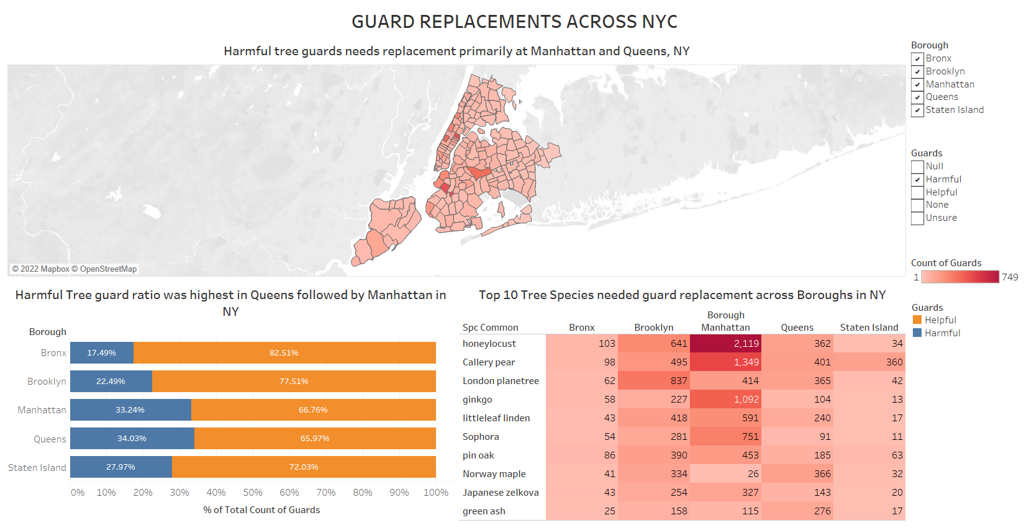

Slide 10
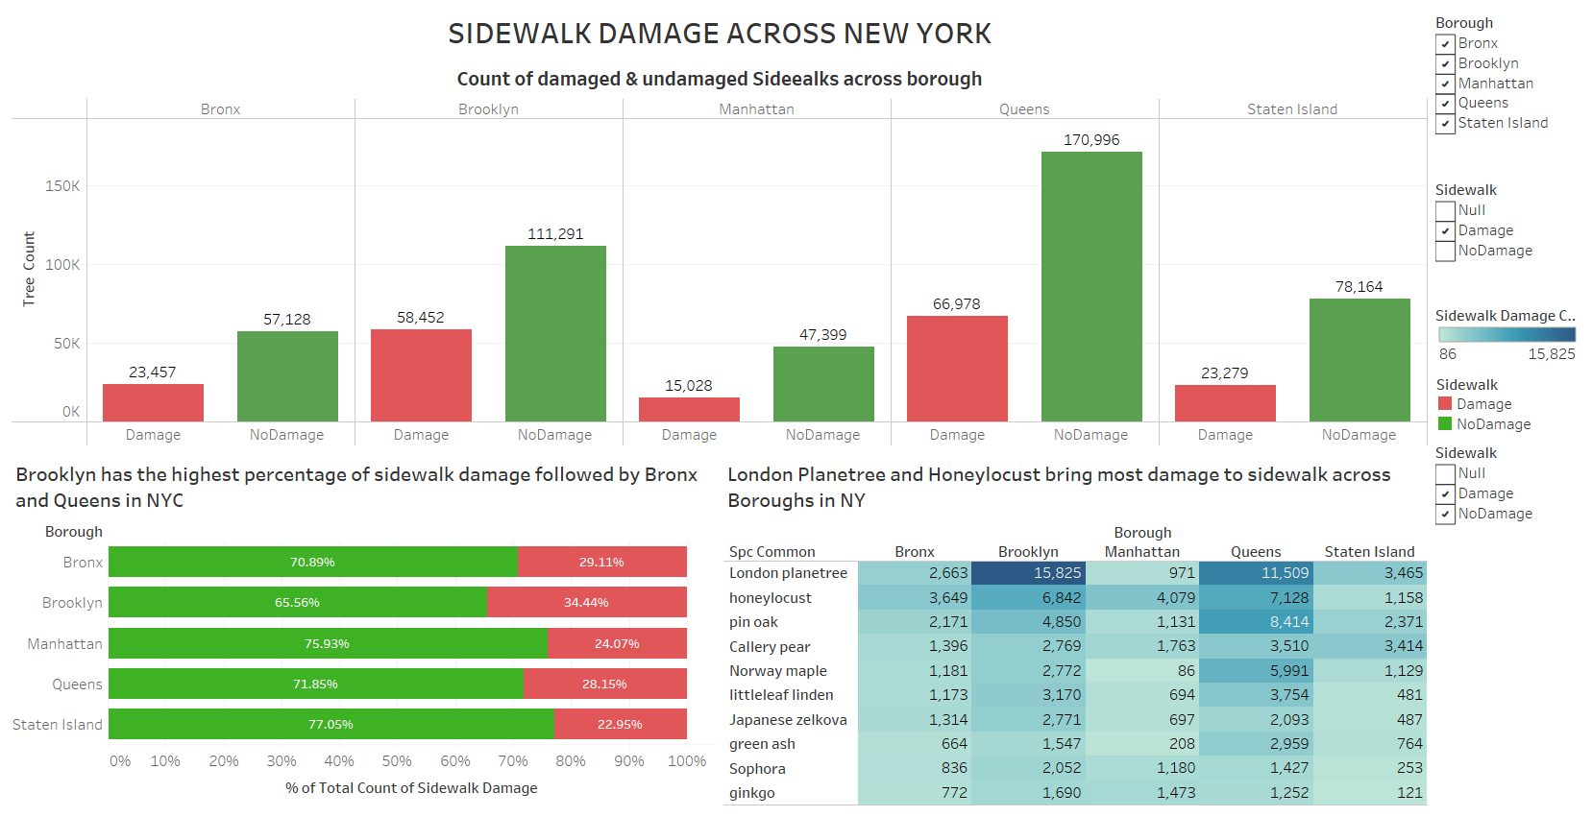

Slide 11
Inferences:
81 % of the survey tree showed to have good health status.
14.5% of the surveyed tree showed to have fair health status.
4.5 % of the surveyed trees showed to have poor health status.
95.4% of the surveyed tree has its status as alive.
2.6% of the surveyed trees has its status as Stump.
2% of the surveyed trees has its status as Dead.
Two postal codes, 10312 & 10314 present in borough Staten Island has the highest density of plant among all the postal codes.
Majority of the tree have a diameter between 10 – 32 inches regardless of their Health status.
Honey locust, London Planetree, and Callery Pear are the three most common species found across New York.

Slide 12
Inferences:
Honey locust is common in Manhattan & Bronx whereas London Planetree is common In Brooklyn & Queens.
Most common problem associated to plant are related to its roots.
Norway Maple is highly prone to root problems and branch problem.
London Planetree is highly prone to trunk problems.
Harmful plant guard ratio is highest in queens followed by Manhattan among all the boroughs.
Honey Locust is the species which require highest number of guard replacement among all the species.
Brooklyn reported the highest percentage of side walk damages among all the borough followed by Bronx & Queens.
The species London Planetree & Honey locust causes higher damages to sidewalk among all the species.

Slide 13
THANK YOU

